Slide 1
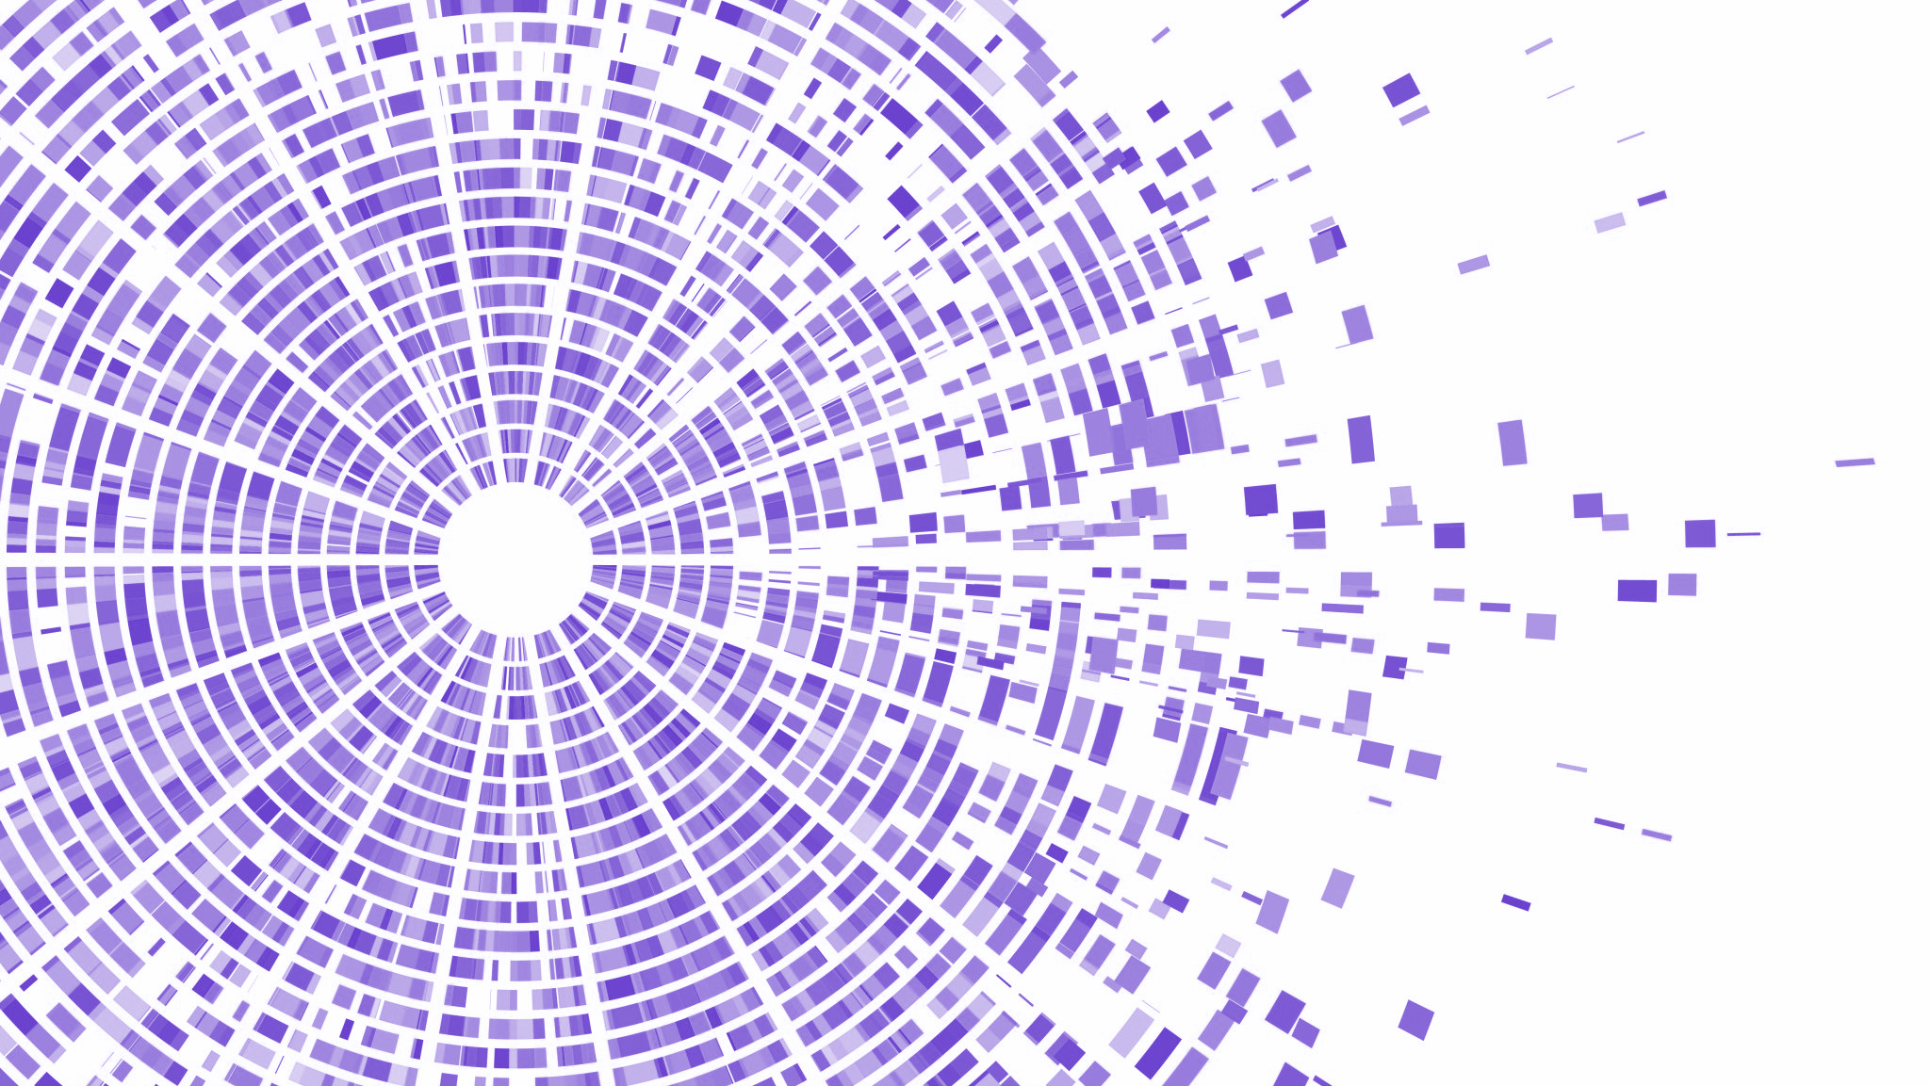

Yelp dataset
Social Network Analysis and Recommender System
Sérgio Rodrigues da Gama (up201906690)
Carlos Gomes (up201906622)
Afonso Monteiro (up201907284)

Slide 2






DATASET DIMENSION
150 346 businesses
6 990 280
reviews
908 915
tips
1 987 897
users
131 930
check-in’s
Loading time
(with Python 3.10.8, Intel Core i7 , 8th Gen and 16Gb of RAM)
15.2 minutes

Slide 3
Dataset Description
The dataset is mainly composed of these two entities, reviews and users, which is comprehensive, as Yelp main focus is giving users a platform to make reviews.
A review links a user and a business, through their respective ids and it is also linked to a date. Additionally, it is composed of the text, stars rating, as well as 3 different vote types, over the review itself (useful, funny, cool).
A user is mainly composed of its name, review, votes, fans and compliments’ counts, yelp joining date, its friends’ list and the average starts rating given by that same user.

Slide 4
Dataset Description
With considerably fewer entries, the dataset is also composed of the businesses for which the reviews are made, as well as tips, that are like smaller review and check-ins, which represents a physical entrance into the business by a user.

Slide 5
WHAT WE
ACTUALLY USED
14 825 businesses
29 657
reviews
1000
users
Loading time
(with Python 3.10.8, Intel Core i7 , 8th Gen and 16Gb of RAM)
0.0175 minutes

Slide 6
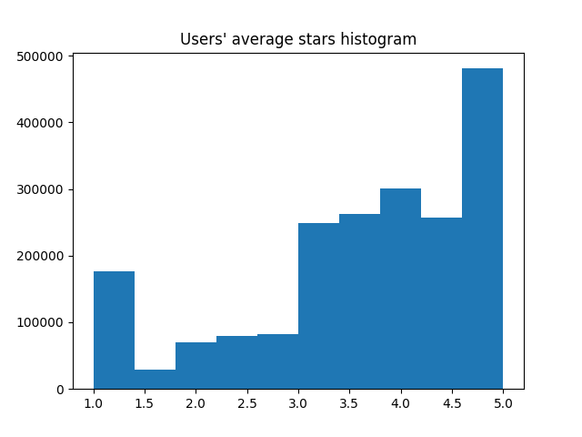
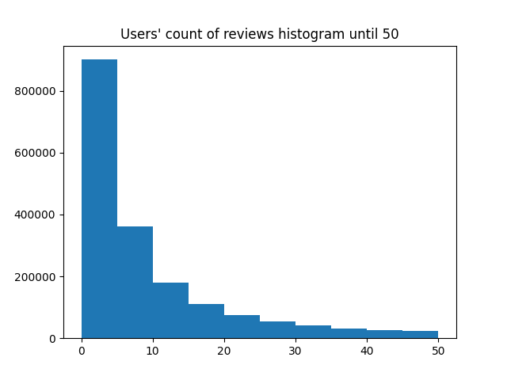
Data Understanding
This is the average starts rating of the entire dataset, before the creation of our sample. As it can be seen in the figure, the users rated businesses a lot more frequently with 3 or higher starts, than the smaller values.
In this figure we can see the amount of reviews per user, also before sampling. It is obvious that the majority of users don't make a lot more than 10 reviews.

Slide 7
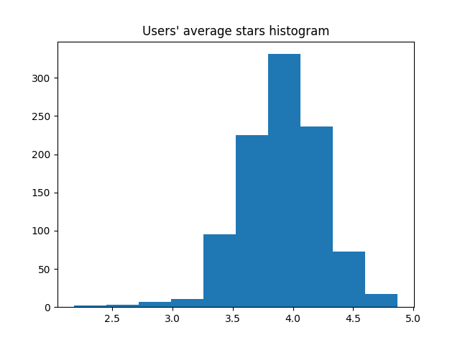
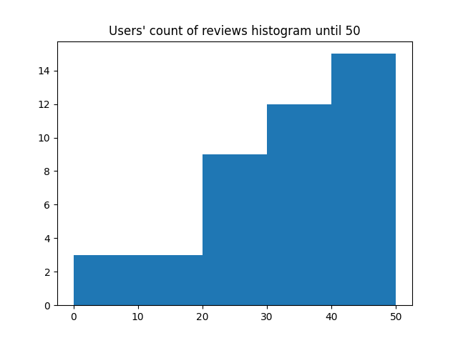
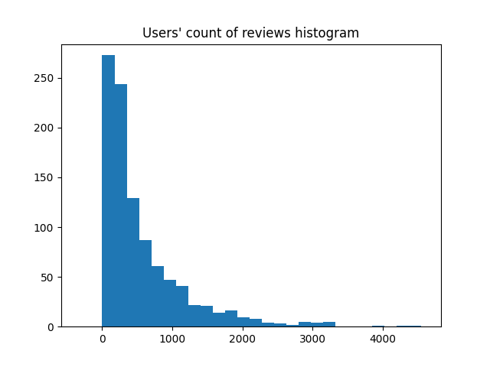
Data Understanding
Both this histograms were also created after the sampling, but they are presented in different scales. In the top figure, with the same scale as the original dataset analysis, is almost the opposite distribution of reviews of the entire dataset. However, by analysing a scale that covers the entire sample, the distribution is the expected one.
This is the average starts rating after the creation of our sample. As it is expected, the ratings are not very different from the entire dataset.
There’s an average of 3.8434 stars in the sample.

Slide 8
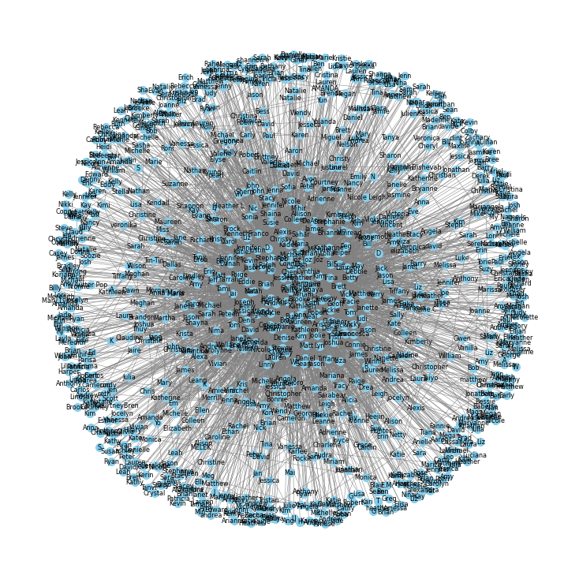
Data Understanding
Friendships Graph
Following the creation of the sample, to analyse the network of users we created a graph in which we can see the friendships between the users.

Slide 9
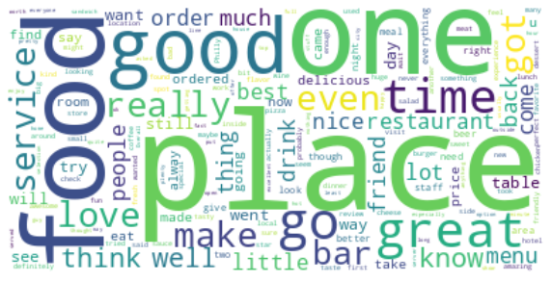
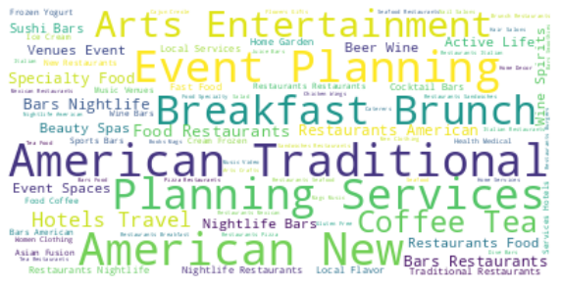
Data Understanding
Word Cloud of Reviews’ Text
Word Cloud of Businesses Categories
After an overview on this wordcloud we can see that reviews on food are very common on the dataset and there’s more positive words than negative words, which can be confirmed by the previous mean of 3.8 in reviews rating.
The Categories wordcloud validate the previous conclusion that there are a lot of reviews involving food, there are lots of food service business

Slide 10
RECOMMENDER
SYSTEM
Singular Value Decomposition
K Nearest Neighbors
Model-based
Collaborative Filtering
User-based
Collaborative Filtering
Data Representation Memory vs. Model Scalability Cold Start Problem

Slide 11
Recommender System
Objective:
Given the users' business ratings recommend new business to users, of their interest.
Algorithms:
We used two algorithms to perform two different collaborative-filtering techniques, SVD to perform a model-based one, while KNN was used to perform a user-based one.
The first one is a model-based approach that aims to discover latent factors that influence user-item interactions. The other is memory-based approach that relies on the similarity between users to make recommendations.
Our Approach:
Create a recommender system using both these techniques and compare them. Additionally, we also ran the system in the communities and checked the analysed the results and the changes in performance.
Performance evaluation: we used the categories attribute of reviews to calculate the relevance of a business to a user. We consider the businesses that have at least one category in the top n (3 or10) categories on which users had done positive reviews, 4, or 5 stars.

Slide 12
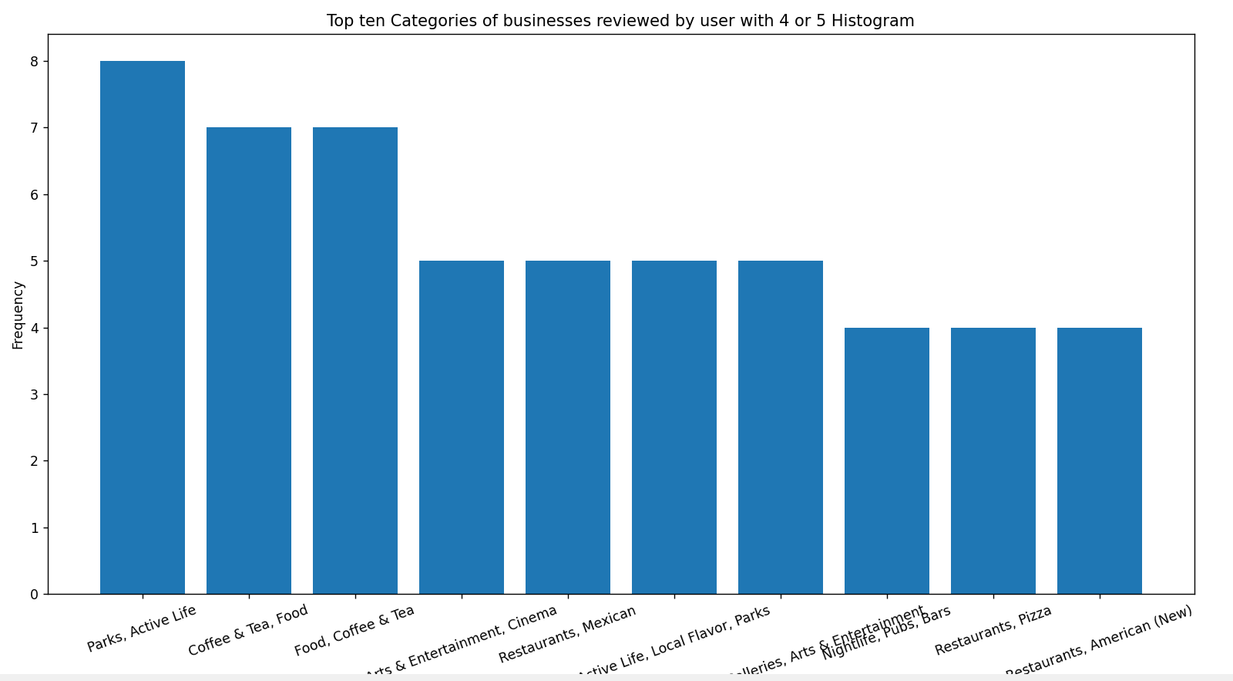
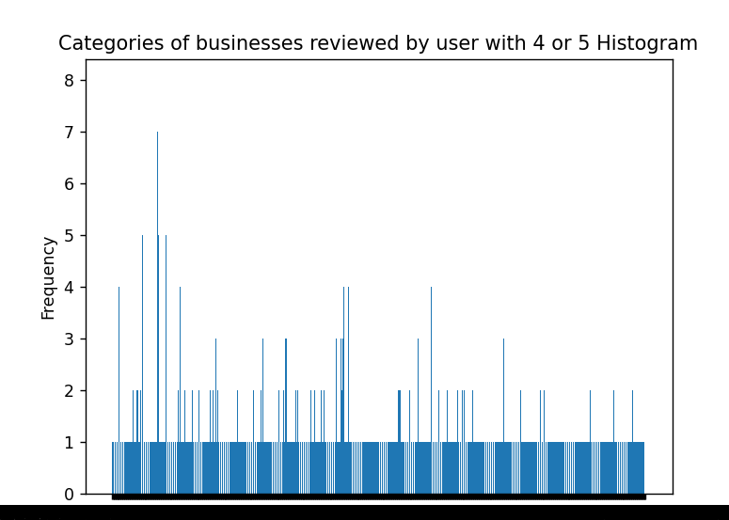
Recommender System
We used a random user called Bill for testing, and that user had made reviews that contemplates a total of 58 categories.

Slide 13
Recommender System: SVD - Bill
Business Name | Categories | Relevant (top 10) | Relevant (top 3)
Blue River Canyon Day Spa & Store | Day Spas, Beauty & Spas | No | No
Chris's Sandwich Shop | American (Traditional), Restaurants, Pizza, Sandwiches, Meat Shops, Food, Wraps, Delis, Specialty Food, Salad | Yes | Yes
Holiday Inn Express & Suites Tampa-Fairgrounds-Casino | Venues & Event Spaces, Event Planning & Services, Hotels, Hotels & Travel | No | No
IndeBlue Modern Indian Food & Spirits | Cocktail Bars, Food Delivery Services, Nightlife, Breakfast & Brunch, Food, Bars, Event Planning & Services, Caterers, Restaurants, Indian | Yes | Yes
Sizzler | Steakhouses, Seafood, American (Traditional), Restaurants | Yes | No

Slide 14
Recommender System: KNN - Bill
Business Name | Categories | Relevant (top 10) | Relevant (top 3)
Palermo's Pizza | Restaurants, Pizza | Yes | No
Walgreens | Shopping, Cosmetics & Beauty Supply, Convenience Stores, Beauty & Spas, Food, Drugstores | Yes | Yes
LC's Cafe & Supper Club | Restaurants, Party & Event Planning, Event Planning & Services, Sandwiches, Cafes, Spanish, Breakfast & Brunch | Yes | No
Jump On The School Bus | Wedding Planning, Transportation, Party Bus Rentals, Wineries, Party & Event Planning, Local Flavor, Food, Wine Tours, Arts & Entertainment, Tours, Limos, Event Planning & Services, Hotels & Travel | Yes | Yes
Wedge + Fig | Specialty Food, Salad, American (New), Sandwiches, Food, Desserts, Breakfast & Brunch, Restaurants, Cheese Shops | Yes | Yes

Slide 15
KNN
Average Similarity Between Results
VS
SVD
Using a random sample, of 100 users, of the already sampled dataset. We calculated the average of the similarity between the results produced by KNN and SVD algorithms, obtaining the 20 top recommendations for those users.
For our surprise the similarity was close to 0%, 0.357%
Although, after some research we found out it is quite common, as they use such distinct methods, KNN focuses on finding similar users or items, while SVD focuses on capturing latent factors.

Slide 16
Recommender System:
Recommendations in Community (using GMC and SVD algorithms, and Bill as user)
Business Name | Categories | Relevant (top 10) | Relevant (top 3)
Chris's Sandwich Shop | American (Traditional), Restaurants, Pizza, Sandwiches, Meat Shops, Food, Wraps, Delis, Specialty Food, Salad | Yes | Yes
El Quetzal | Shopping, Flowers & Gifts, Gift Shops, Women's Clothing, Fashion, Jewelry | Yes | No
Balance Chiropractic Health Center & Spa | Massage, Active Life, Health & Medical, Fitness & Instruction, Chiropractors, Beauty & Spas, Dance Studios, Acupuncture, Yoga | Yes | Yes
Penn's Landing | Arts & Entertainment, Active Life, Skating Rinks, Local Flavor, Parks, Music Venues, Nightlife | Yes | Yes
The Wrap Shack | Restaurants, Sandwiches | Yes | No

Slide 17
Recommender System: Results
There were created 64 communities with the GMC algorithm, and as SVD is a model-based technique and it captures the latent factors, we observed that doing the recommendations inside the community increased the performance, in both relevance test cases.
This is most likely to do the fact that by only using the communities information the latent factors that affect a user in the said community are easier to discover, without any noise.
In addition to that, we concluded that KNN had a better performance that SVD, getting 1.0 of precision, considering the top ten relevant and 0.6 in the top 3
Method | Relevant (top 10) | Relevant (top 3)
SVD | 0.6 | 0.4
KNN | 1 | 0.6
SVD (community) | 1 | 0.6
We only used precision as an evaluation metric, because it is the most important one in a recommender system. It doesn't matter if a system of that kind has 90% recall, unless those 90% appear first and are recommended.
precision values table

Slide 18
Recommender System: KNN vs SVD
However, testing with one user is not enough to draw significant conclusions, so we calculated the average precision of the recommendations, given by the knn and the svd, separately, for a sample of 100 users.
We used the top 5 relevants and used 10 recommendations returned per user in each iteration, to calculate these values:
SVD: 0.97
KNN: 0.96
Therefore, even tho we observed a major difference in results when analysing things at a smaller scale, using a single test user, we can conclude that in general, both algorithms perform well and obtain plausible results, as we obtained almost the same average precision in this tests, for both of them.

Slide 19
SOCIAL NETWORK ANALYSIS

Slide 20
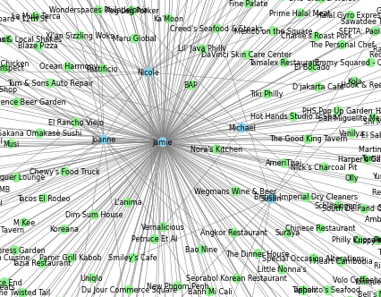
Social Network Analysis: Graph
Weighted Bipartite Graph
Nodes: Users and Businesses
Edges: Reviews*
Edge Weight: Review Rating
Number of Nodes: 15,825
Number of Edges: 28,424
* There was also the possibility of adding edges between each user, similar to the graph we saw before, but most algorithms treat all edges as the same type and do not consider edge attributes. We would need to separate them to analyse it individually but since our focus are the reviews, we only consider these as edges.

Slide 21
Social Network Analysis: Centrality Analysis
Degree centrality:
measures the number of edges connected to a node.
A high degree centrality for a user node could indicate that the user is very active in reviewing businesses.
A high degree centrality for a business node could indicate that the business is popular and has been reviewed by many users.
Eigenvector centrality:
measures the influence of a node based on the number and importance of its connections.
For a user node, represents the user’s influence in the network based on their connections to influential businesses, a high value could indicate that the user has reviewed many influential businesses.
For a business node, represents the business’s influence in the network based on their connections to influential users, a high eigenvector centrality for a business node could indicate that the business has been reviewed by many influential users.

Slide 22
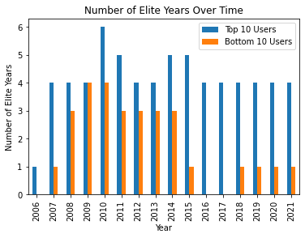
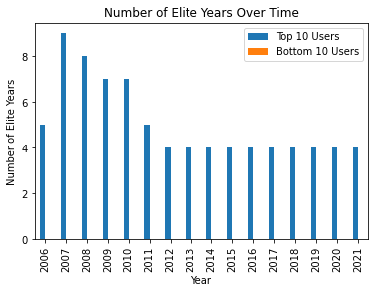
Social Network Analysis: Centrality Analysis
To test how results we compared the top vs bottom degree centrality of 10 users’ elite* years.
Degree Centrality
Eigenvector Centrality
*The Yelp Elite Squad recognizes active and exemplary members of the Yelp community based on well-written reviews, high-quality photos, a detailed profile, and positive interactions. They enjoy exclusive events, engaging with business owners, and experiencing unique activities.

Slide 23
Social Network Analysis: Link Analysis
HITS vs PageRank
For this specific graph, we decided to only use Page Rank since HITS does not consider edge’s weight.
To do it we did the following implementation:
n = len(B.nodes())
A = nx.adjacency_matrix(B).todense()
P = np.zeros((n,n))
for i in tqdm(range(n)):
for j in range(n):
if A[i,j] > 0:
P[i,j] = A[i,j] / A[i,:].sum()
d = 0.85
n = len(B.nodes())
r = np.ones((n,1)) / n
for i in tqdm(range(100)):
r = d * P.T @ r + (1 - d) / n
pagerank = {}
for i, node in enumerate(B.nodes()):
pagerank[node] = r[i,0]
Create an adjacent matrix represents the connections between nodes in the graph, where A[i,j] is the weight of the edge from node i to node j and P[i,j] represents the probability of transitioning from user i to business j based on the star rating of their review
Set damping factor to 0.85 based on empirical evidence on large datasets. (parameter that controls the relative importance of the transition probabilities in the calculation of the PageRank scores)
A rank vector r is initialized with all elements equal to 1/n, where n is the number of nodes in the graph. Represents the initial importance scores of all nodes updated iteratively using a formula that represents a weighted combination of two factors: the first term (d * P.T @ r) represents the importance scores propagated from neighboring nodes through the edges of the graph, while the second term ((1 - d) / n) represents a random jump to any node in the graph with equal probability.
Finally, a dictionary is created to store the final importance scores of all nodes, where the keys are node labels and values are their corresponding importance scores.

Slide 24
Social Network Analysis: Link Analysis
PageRank Results
With the results of the PageRank algorithm we created a very simple recommender system to test the results, where we choose a user and recommend 5 businesses
This recommender system implements a simple user-based collaborative filtering algorithm that recommends items (businesses) to a target user based on the review history of similar users. It calculates the cosine similarity between users based on their review history and recommends items that have been highly-rated by similar users.
Recommendations for Rebecca (id: Pp4doAlCjxOxemlkTc7ERQ):
1. Fido
Categories: Food
2. Monell's Dining & Catering
Categories: Food
3. Pangaea
Categories: Fashion
4. Loveless Cafe
Categories: Food
5. Nashville International Airport - BNA
Categories: Hotels & Travel

Slide 25
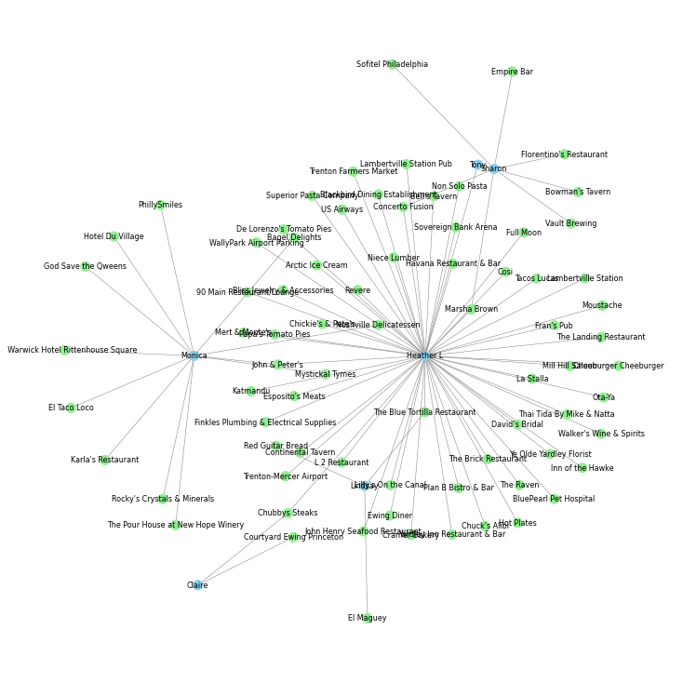
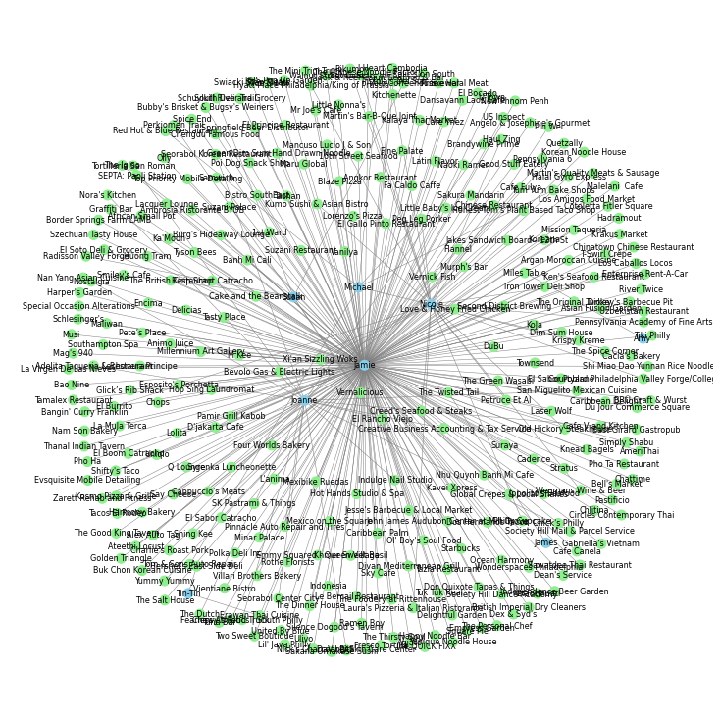
Social Network Analysis: Community Detection
In this section we use 2 algorithms of community detection Greedy Modularity and Label Propagation, which retrieve 64 and 778 communities, respectively.
Calculated metrics Modularity that measures the strength of the division of a network into communities and Conductance that measures the fraction of total edge volume that points outside the community.
Use communities in recommender system

Slide 26
Conclusions
In this project we were capable of building a good recommender system framework and test it, analysing the differences between the results of distinct algorithms.
We also performed a social network analysis, understanding how the data connected to each other.
Additionally, the social network analysis was merged with the recommender system research, by testing this last one in the communities.
Finally, it allowed us to investigate and learn more about recommender systems and social network analysis, as well as natural language processing, because we started by trying to extract the ratings by the reviews' text itself.

Slide 27
THANK YOU

